Slide 1

IPL DATA ANALYSIS
By:- GAURAV KUMAR ROLL NO-BTECH/15082/18
BIRLA INSTITUTE OF TECHNOLOGY MESRA,
PATNA CAMPUS
Guide: DR RATNESH MISHRA(Assistant Professor)Dept. of CSE , BIT PATNA

Slide 2
Agenda
Introduction
Scope and Motivation
Details of Dataset
Tools and Technology
Visualization
Agenda
Cricket, especially the IPL has the maximum uncertainty where a single over can completely change the whole momentum and circumstances of the game.
Doing Sports analysis is the process of collecting past matches data and analysing them to extract the essential and meaningful insights.
Using descriptive and inferential statistics, this dataset is a gold mine depending on how deep the analysis is done and on top of that the data of 2020 is also available.
Visualisation of this dataset is the key part of our project as it cover lot of factors determining the winner of match.
As the IPL happens every year and is very popular in India therefore analysis
and finding insights can be very useful for future matches.
1/7

Slide 3
Agenda
Introduction
Scope and Motivation
Details of Dataset
Tools and Technology
Visualization
Introduction
The idea is to analyze the IPL data hosted by Kaggle to come up with something interesting and useful.
The insights from the dataset can really be helpful for the IPL management and team coach to improve themselves.
Handling all the factors like effect of homeground and toss winner is the real world problem.
For the future progress, PYTHON model can be applied to determine the probability of winning a match on the basis of previous data.
the dataset consist of data about IPL matches played from the year 2008 to2020.IPL is a professional Twenty20 cricket league founded by the Board of Control for Cricket in India (BCCI) in 2008. The league has 8 teams representing 8 different Indian cities or states. It enjoys tremendous popularity and the brand value of the IPL in 2019 was estimated to be ₹475 billion
1/7

Slide 4
Agenda
Introduction
Scope and Motivation
Details of Dataset
Tools and Technology
Visualization
Scope and Motivation
Predicting the winner of the next season of IPL based on past data can give us idea that which team has higher probability of winning the match which seems pretty interesting.
As the dataset tell about the team, who won the toss along with the information of venue and man of match. The chances of winning the match by that team can also be determined on basis of these factor which is beneficial for sponsors and advertisement also.
As a cricket enthusiast, working on this dataset was fun and getting the insights was interesting.
Predicting the outcome of the match is a challenge but by means of inferential statistics and data visualization we can overcome the challenge to a certain extent.
1/7

Slide 5
Agenda
Introduction
Scope and Motivation
Details of Dataset
Tools and Technology
Visualization
Details of Dataset
The dataset was taken from the kaggle and it contains the latest data of IPL 2020.
The dataset has nearly 636 rows and 18 columns with some missing data and wrong data (which is mostly null values).
The dataset has detailed information about which team won the match by how much margin (wicket or runs depending on the team to opt for batting or bowling).
The dataset has columns telling about the man of match, venue, and the dataset was not sorted on the basis of season so sorting of data was done at beginning.
The column called Umpire3 in dataset was removed because more than 90% of data was missing.
1/7

Slide 6
Data Cleaning
In the Dataset there was lot of missing values in many rows and columns and cleaning the dataset is important to get graphs and insights without errors.
The matches where no result (maybe due to bad weather), the player of match and match-winner cannot be determined therefore data in those cells was filled with 'Not Possible'.
Missing data in the umpire column was replaced with the information present above the cell of missing data by the method of ‘ffill’.
In the city column the same city was written by two different names i.e some columns had Bangalore written in them and some have Bengaluru written.
1/7

Slide 7
Agenda
Introduction
Scope and Motivation
Details of Dataset
Tools and Technology
Visualization
Tools and Technology
The Tools used for the analysis of the dataset are python libraries like:-
Pandas :- Used to import the dataset in various format like csv ,excel etc. and also for the manipulation of data.
Numpy :-Used to do numerical analysis like finding mean, standard deviation and also in linear algebra.
Matplotlib :- It is used for visualization of data in meaningful graphs and charts.
Seaborn :- Is used for making the visualization creative based on matplotlib. It provide high level interface for creating graphs.
Scipy :- Used for finding z-score values and in finding the confidence level of sample taken randomly from dataset .
Math :- It provides access to some common math functions and constants, which can be used for complex mathematical computations.
1/7

Slide 8
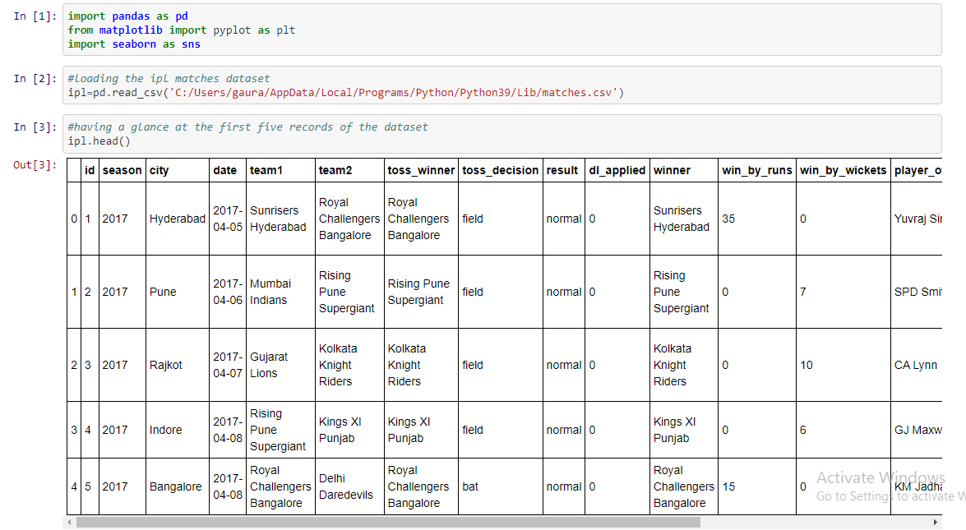
Visualization

Slide 9
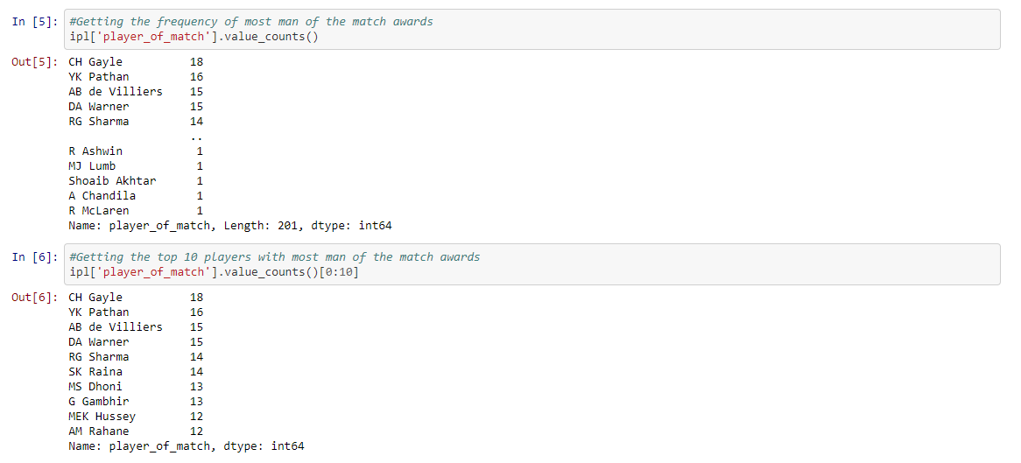
Visualization

Slide 10
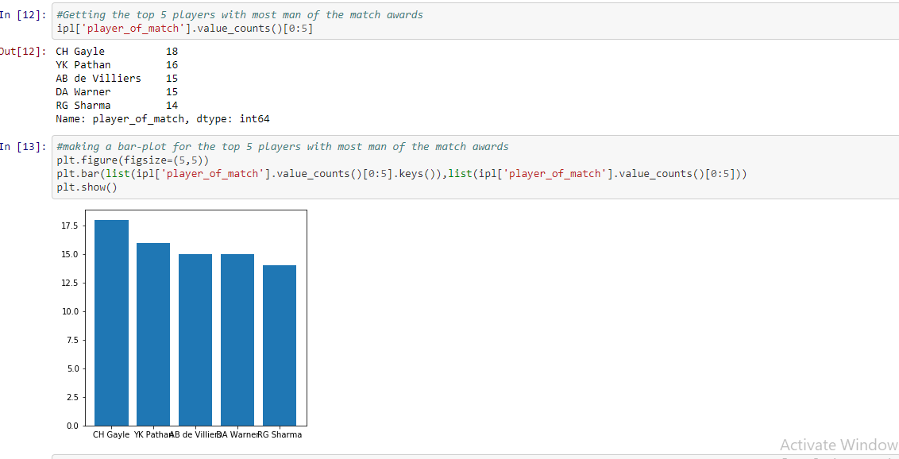
Visualization

Slide 11
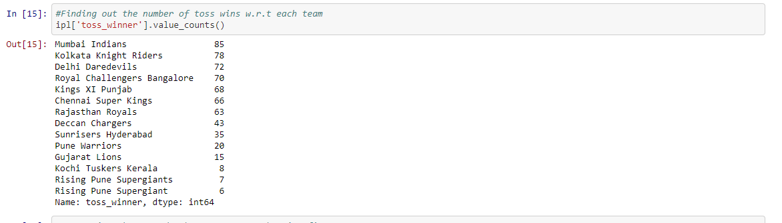
Visualization

Slide 12
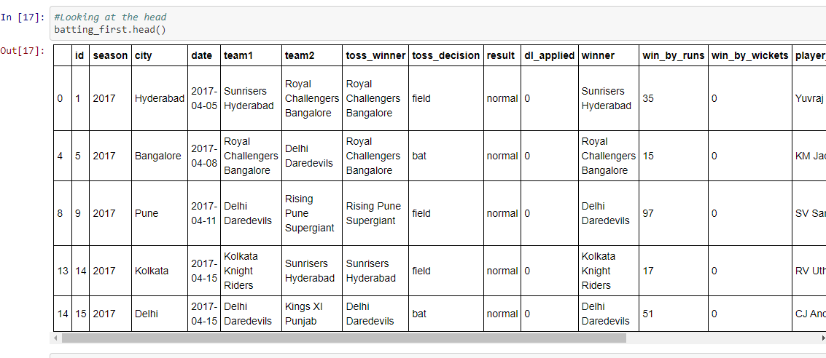
Visualization

Slide 13
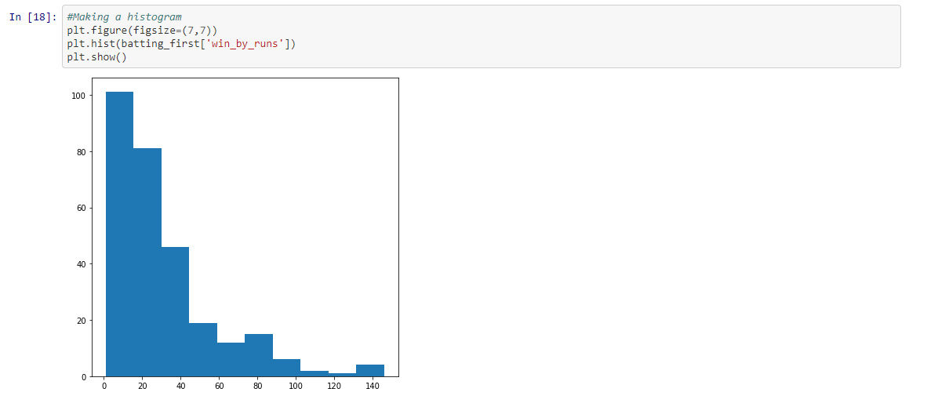
Visualization

Slide 14
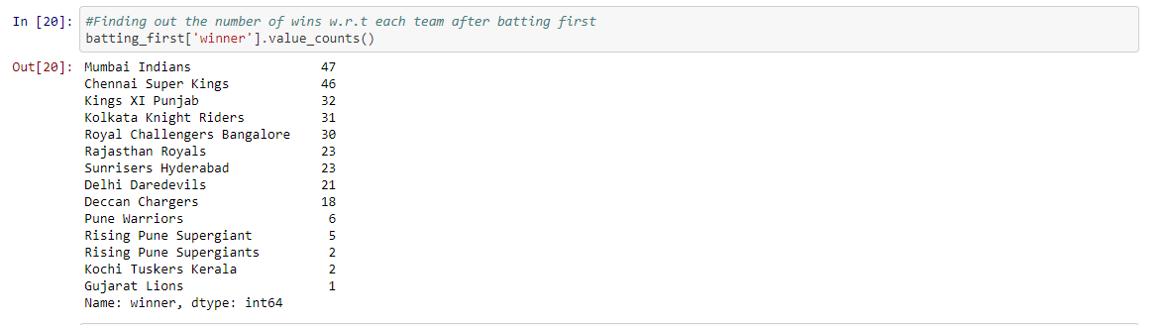
Visualization

Slide 15
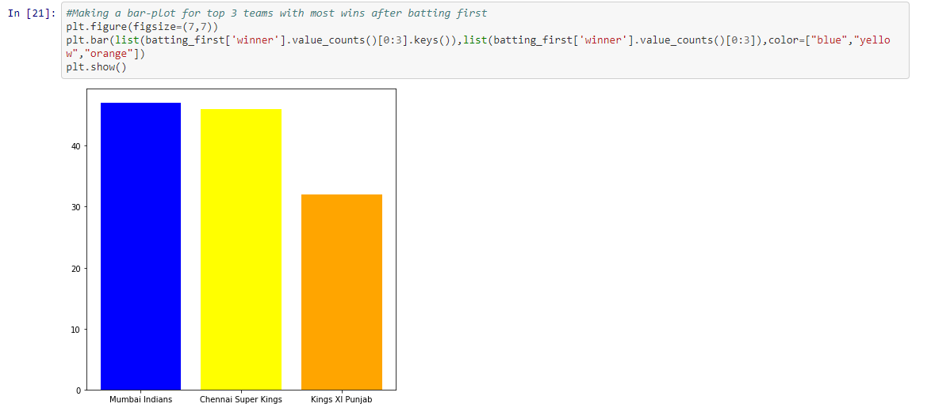
Visualization

Slide 16
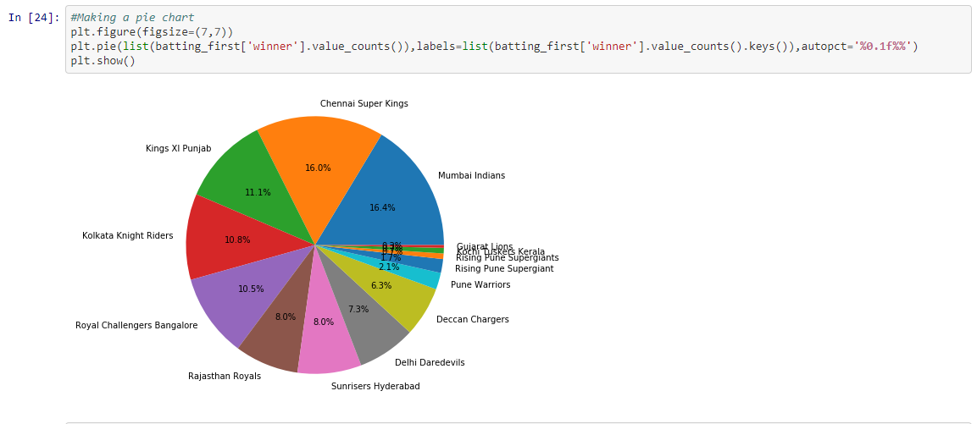
Visualization

Slide 17
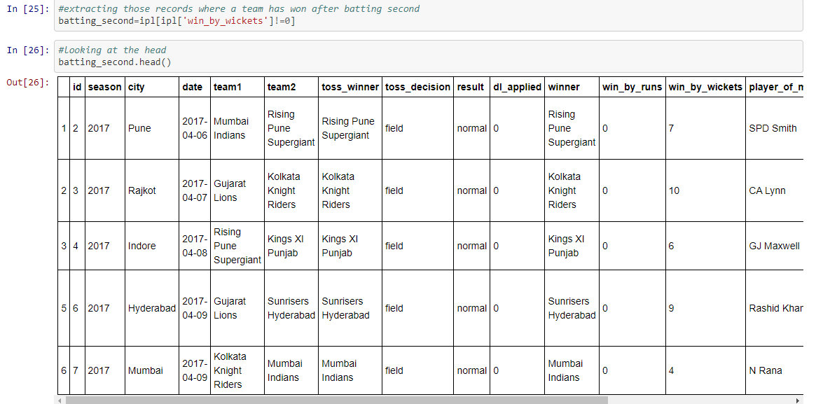
Visualization

Slide 18
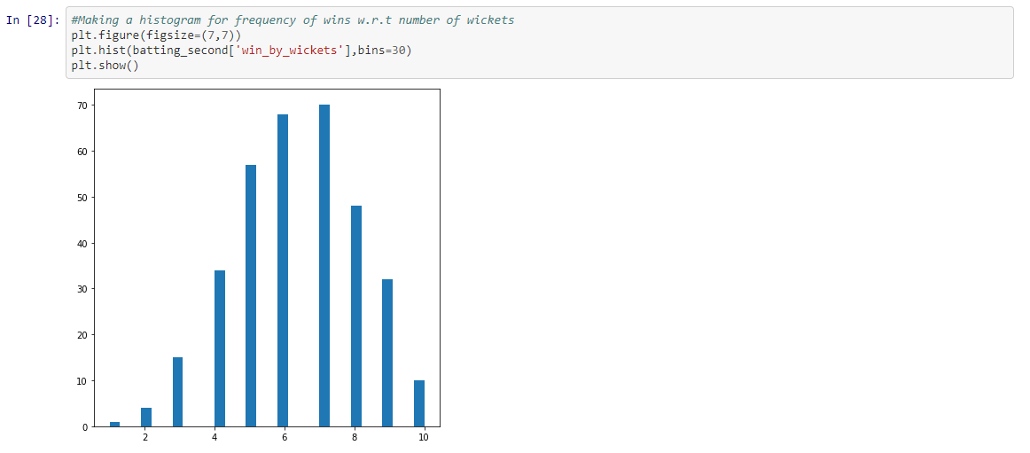
Visualization

Slide 19
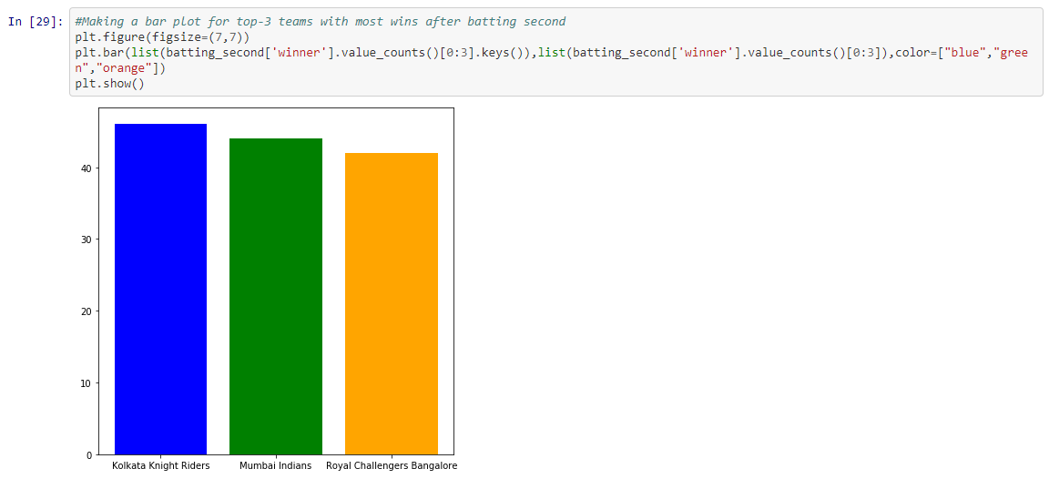
Visualization

Slide 20
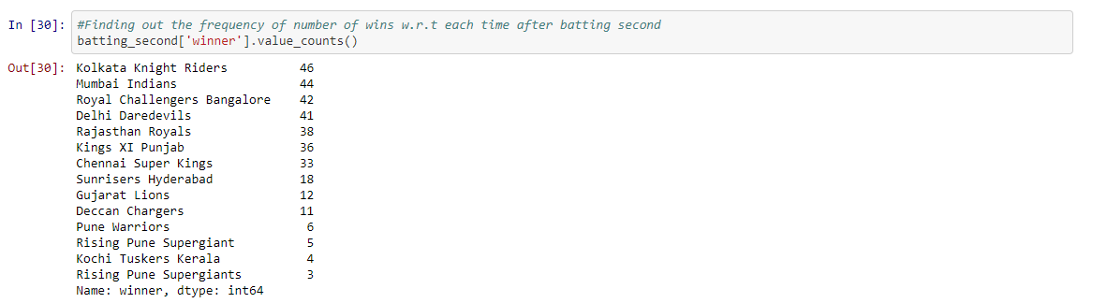
Visualization

Slide 21
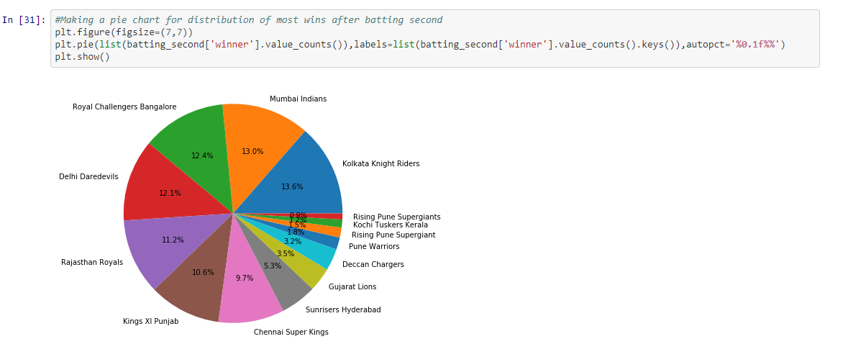
Visualization

Slide 22
CONCLUSIONS
Totally 13 teams has participated in IPL History and few teams like: Pune Warriors, Kochi Tuskers Kerala, Rising Pune Supergiants, Gujarat Lions and Delhi Capitals has been only in 2 seasons and their success rate of is good when compared to other teams.
Mumbai Indians, Royal Challengers Bangalore and Chennai Super kings are best Defending teams.
Royal Challengers Bangalore, Mumbai Indians and Kolkata Knight Riders are the best Chasing teams.
From the year 2014 most of the teams are opting to field after winning toss and are also successful in winning the match.
Overall Chennai Super Kings and Mumbai Indians have high success rate and these two teams are the most successful teams as CSK has won 4 seasons and MI has won 3 seasons.

Slide 23
CONCLUSIONS
From the analysis, it was concluded that Chennai Super Kings and Mumbai Indians are more likely to win upcoming IPL seasons.
Kolkata, Bangalore and Delhi is more likely to have bad weather during the IPL season.
Teams have won more matches in their home grounds.
M Chinnaswamy stadium and Eden Gardens is best Suited for Feilding and MA Chidambaram Stadium,Chepauk is best suited for Batting.
At Mumbai highest number of matches has been played.
Chris Gayle has most title for man of the matches i.e 21.
Delhi Capitals has more chances of winning the toss followed by Deccan Chargers but Delhi Capitals has played only two seasons.
There is no linear relation between win_by_runs and win_by_wicket as correlation coefficient is negative.

Slide 24
References
The dataset was taken from kaggle.com
For determining the outcome of the match, we referred to researchgate.net
For cross checking the details in dataset we referred to www.IPLT20.com
The dataset link is:-
https://www.kaggle.com/nowke9/ipldata#matches.csv
A. K. Jain, M. N. Murty, and P. J. Flynn, “Data clustering: a review”, ACM Computing Surveys 31 (3), pp: 264–323, 1999
J. Han, M. Kamber, and J. Pei, Data Mining: Concepts and Techniques, second ed., Morgan Kaufmann, California, 2005.

Slide 25
References
P. Berkhin, Survey of clustering data mining techniques, Technical Report, Accrue Software, Inc., 2002.
R. Xu and D. Wunsch, “Survey of clustering algorithms”, IEEE Transactions on Neural Networks 16 (3) 645–678, 2005.
M. Filippone, F. Camastra, F. Masulli, and S. Rovetta, “A survey of kernel and spectral methods for clustering”, Pattern Recognition 41, 176–190, 2008.
L. A. Zadeh, Fuzzy sets: Information and Control, 1965..
L. A. Zadeh, From search engines to question-answering systems the role of fuzzy logic, University Berkeley, California.

Slide 26
References
http://www.iplt20.com/
http://en.wikipedia.org/wiki/Indian_Premier_League
http://www.espncricinfo.com/indian-premier-league2012/content/current/series/520932.html
http://articles.economictimes.indiatimes.com/keyword/indian-premier league

Slide 27
Thank You

